Slide 1

ZS Associates Data Science
Building Permit Status Classification

Slide 2
Index
Dataset to Explore
Features to Engineered
Locational observation
Features from Locational data
Date Time Conversion
Handling Text data
Catboost makes Best Choice
Catboost Results
Deep Learning Model
Challenges and Improvement
Summary & Takeaway

Slide 3
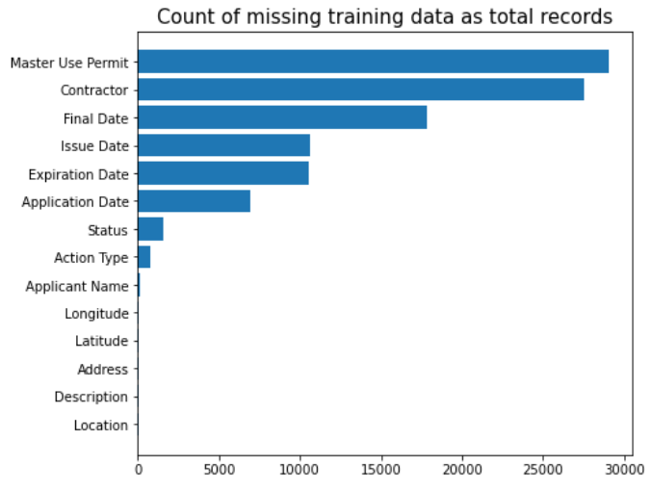
Dataset to Explore
Uniqueness across features
Missing Values

Slide 4
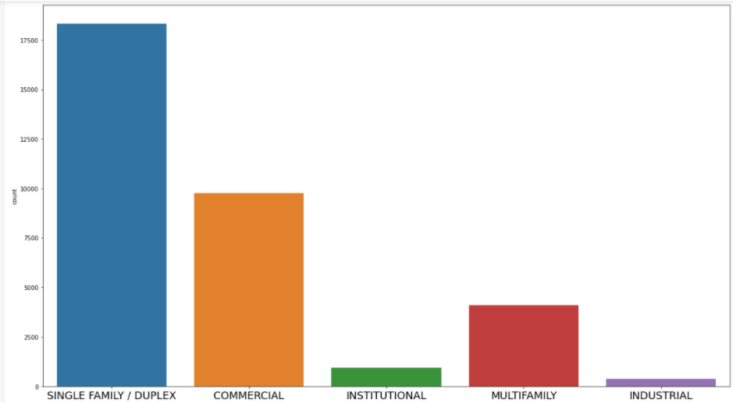
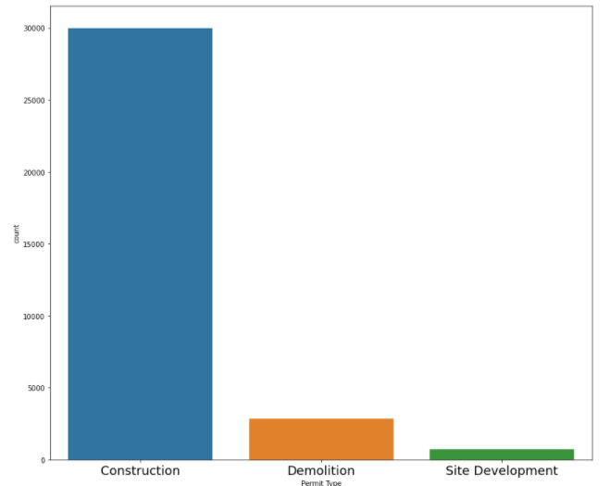
Dataset to Explore
Category count plot
Permit type

Slide 5
Features to Engineered
Location features
Date and Time features
Categorical and Numerical
Text Feature
Application Date
Issue Date
Final Date
Expiration Date
Action Type
Work Type
App/Permit no
Permit Type
Contractor
Applicants Name(opt)
Description
Latitude
Longitude

Slide 6
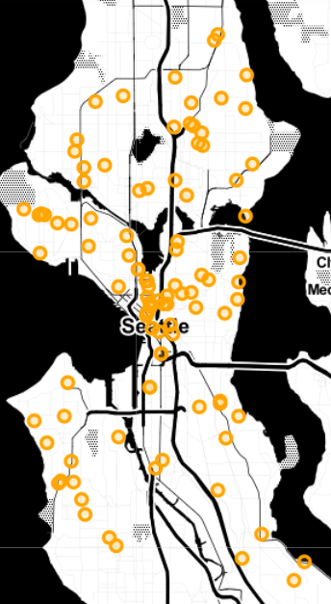
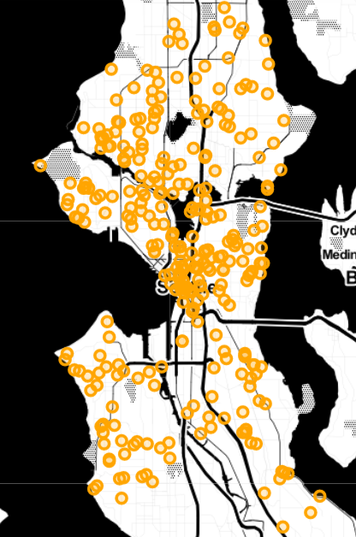
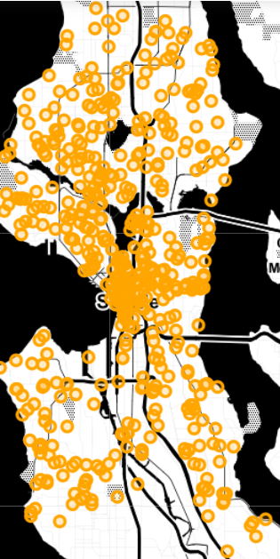
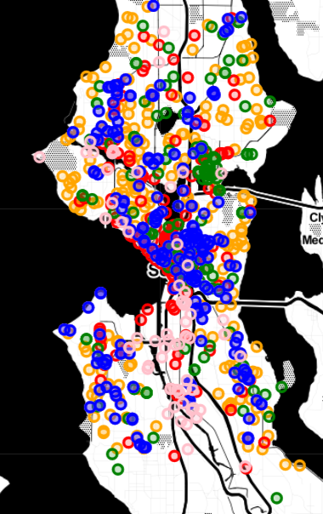
Locational observation
0-100 Locations
101-300 Locations
400 – 700 Locations
Permit Issued vs Categorical

Slide 7
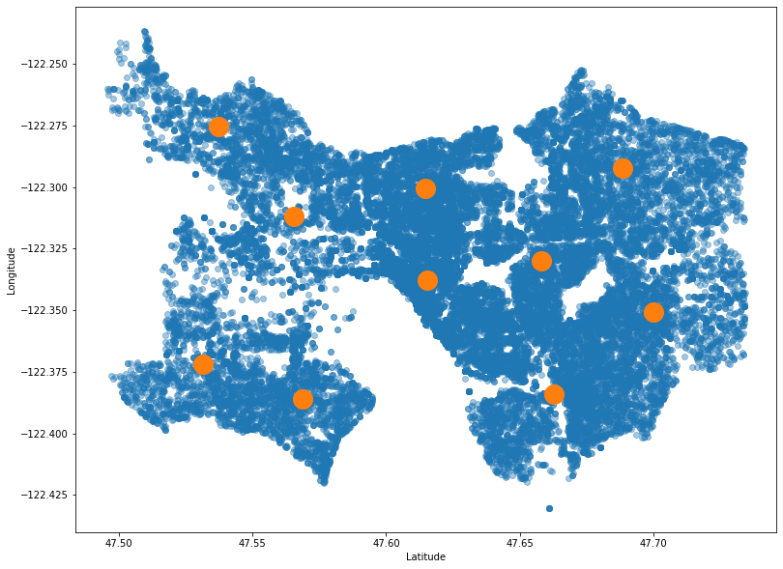
Features from Locational data
Clustering
KMeans : Easy to Manifest shown in figure.
DBSCAN: Gives better results but computationally expensive.
Used 10 Clusters

Slide 8
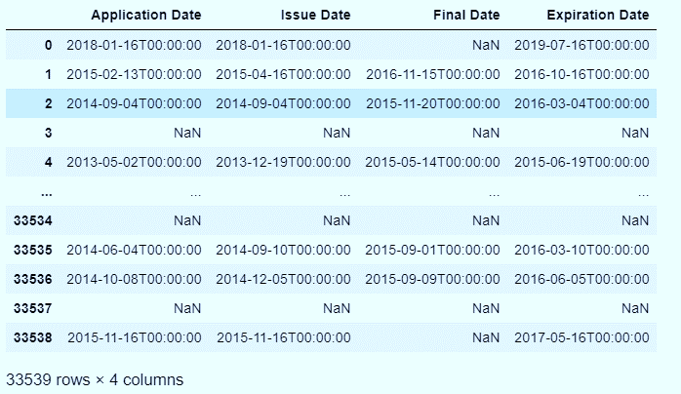
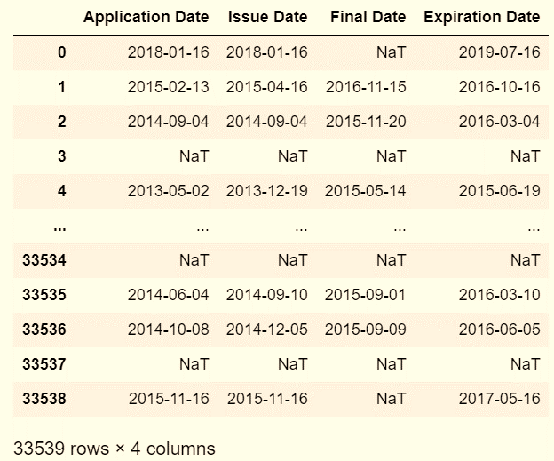
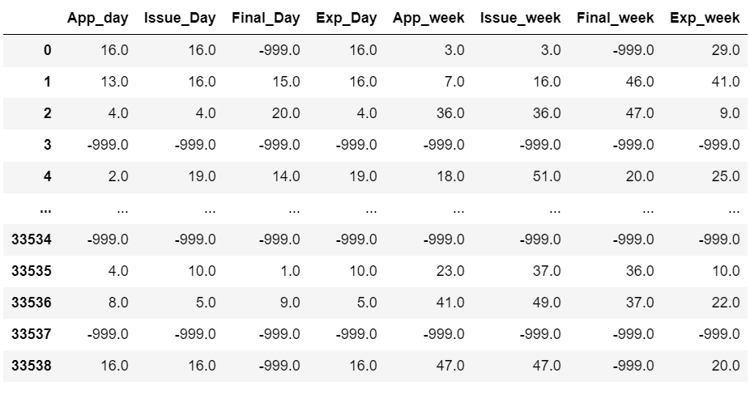
Date time conversion

Slide 9
Handling Text Data
TF-IDF : Challenging to convert into text into features as columns as computationally Expensive
MemoryError: Unable to allocate 4.25 GiB for an array with shape (17021, 33539) and data type float64
Solutions
Deep learning analysis to check Relationship, Impact of text with our output label.
TF-IDF with Maximum features parameter used for better decisions for our model.
Used some components of number of words, no of unique word and ratio for getting more features.

Slide 10
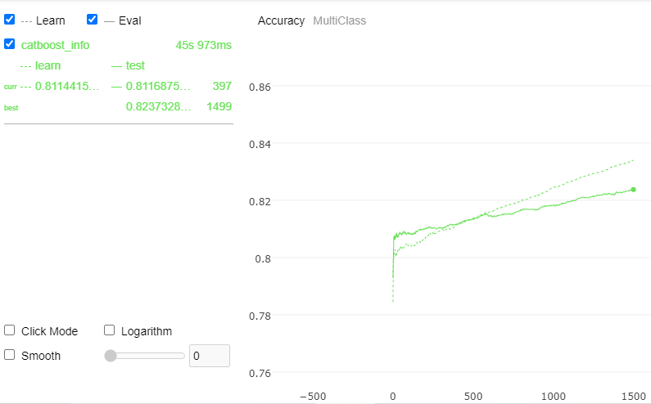
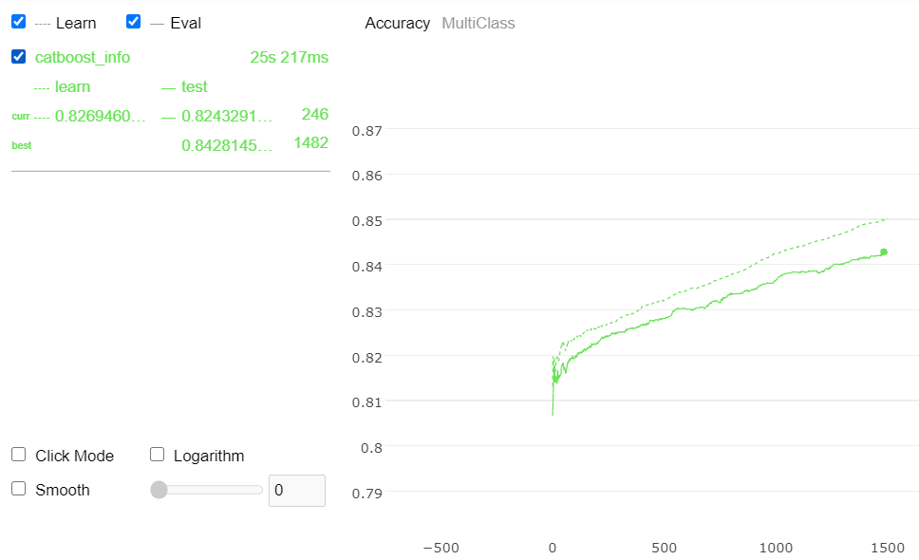
Handling Text Data[1]
TF-IDF with max features 20
TF-IDF with max features 50

Slide 11
Catboost makes Best Choice
Handles Multiple types of features: Text data, categorical variables, Numerical data
Handles Missing Values: Missing numerical with min, max and Missing Text as ‘’
Robust: Reduces need for extensive hyperparameters tuning.
Can be optimized with Randomized search to get optimal Hyperparameter.

Slide 12
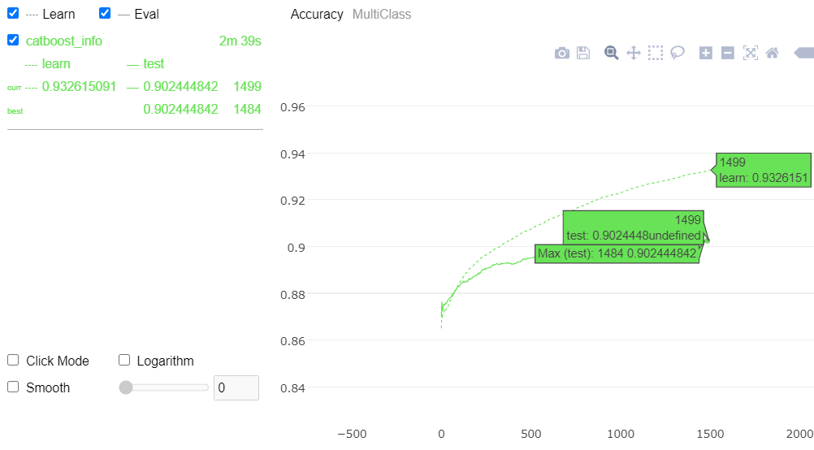
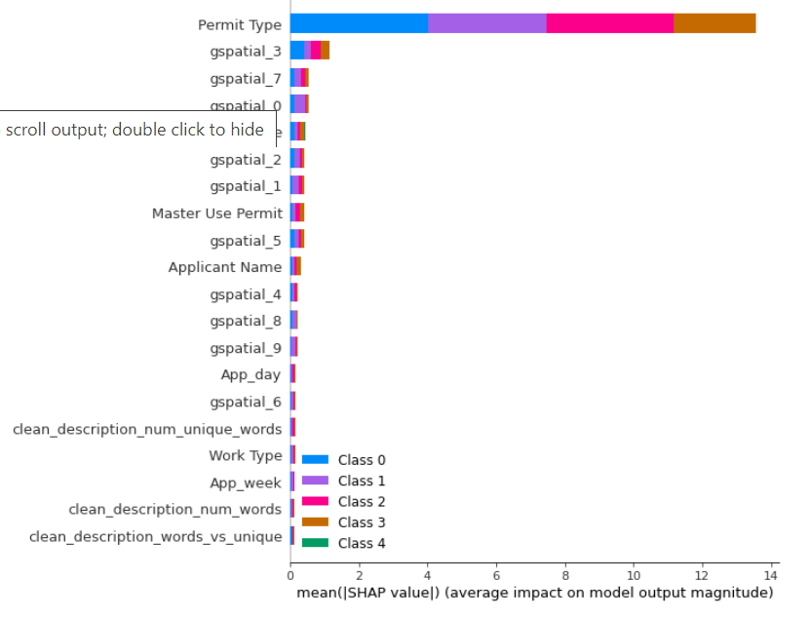
Catboost Results

Slide 13
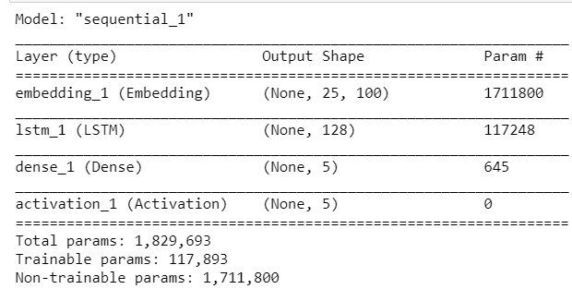
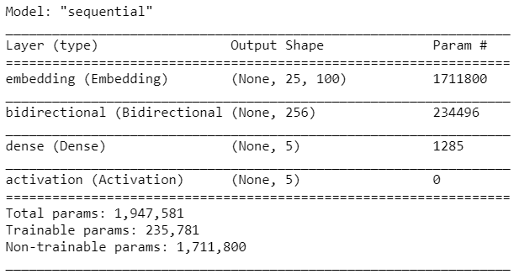
Deep Learning Model
Glove + LSTM Epochs 5 to 100, Accuracy: achieved 85 to 90%
Glove + BiLSTM Epoch 5 to 100 91%

Slide 14
Challenges and Improvements
Location data was unable to process using DBSCAN.
TF-IDF was unable to compute due to expensive computation
EDA and Feature Engineer can be further analyze for diagnosis.
Other ML algorithm can be explored to achieve better performance and computations.
Deep Learning can be used by combining text and other features.
Why ?? Is it Elasticity, Zoning

Slide 15
Summary & Take away
Build workflow for feature engineering of Multiple Data types
Used KNN and TF-IDF for Locational and Text features conversion.
Build Catboost model as its outperforms various ML algorithms and shown accuracy of model.
Used Glove embedding and LSTM, BiLSTM to bring language modeling capability in future.
Identified keyholes which can be furnished.
We summarize various class distribution using Explainer Dashboard.
Explainer Dashboard Demo !!

Slide 16
QA

